Slide 1
Instant hot water. Long-term savings.
Month 09, 2017
ecocirc® wireless
Domestic hot water Recirculation kit

Slide 2
No more waiting!
Frustrated waiting for hot water? Remove the waiting time simply by adding an ecocirc® wireless kit to your existing domestic hot water system, and you can:
Enjoy instant hot water everywhere you need it in your home
Stop dumping thousands of gallons of water down the drain
Reduce your water, sewage and energy costs immediately

Slide 3
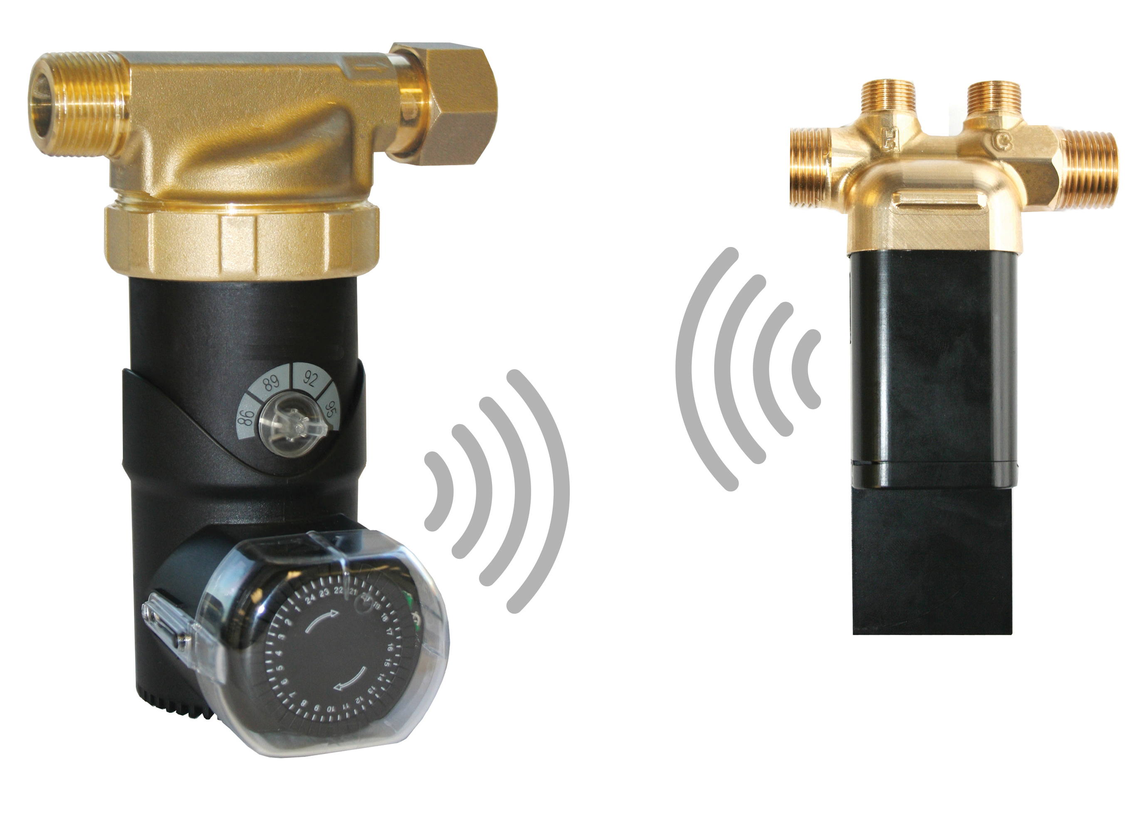
Two simple parts
The ecocirc® wireless kit Part #6050B4000 includes two parts, both certified for use with drinking water:
A lead-free recirculation pump at your hot water source
A battery-operated mixing valve, with temperature sensor and transceiver, installed under the sink farthest from the hot water source
The two parts communicate with each other wirelessly.

Slide 4
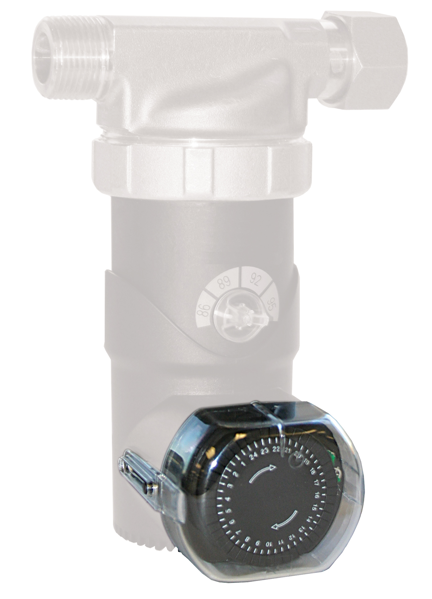
User-friendly timer control
To prevent unwanted cycling and possible tempering of cold water, use the timer to start pump operation 30 minutes before peak demand periods.
For example, if the household’s first high-demand period starts at 6 a.m., set the timer for 5:30 a.m. If the second peak is at 6 p.m., add a setting at 5:30 p.m.
If you regularly need hot water outside peak demand times, consider adding a push button transponder.

Slide 5
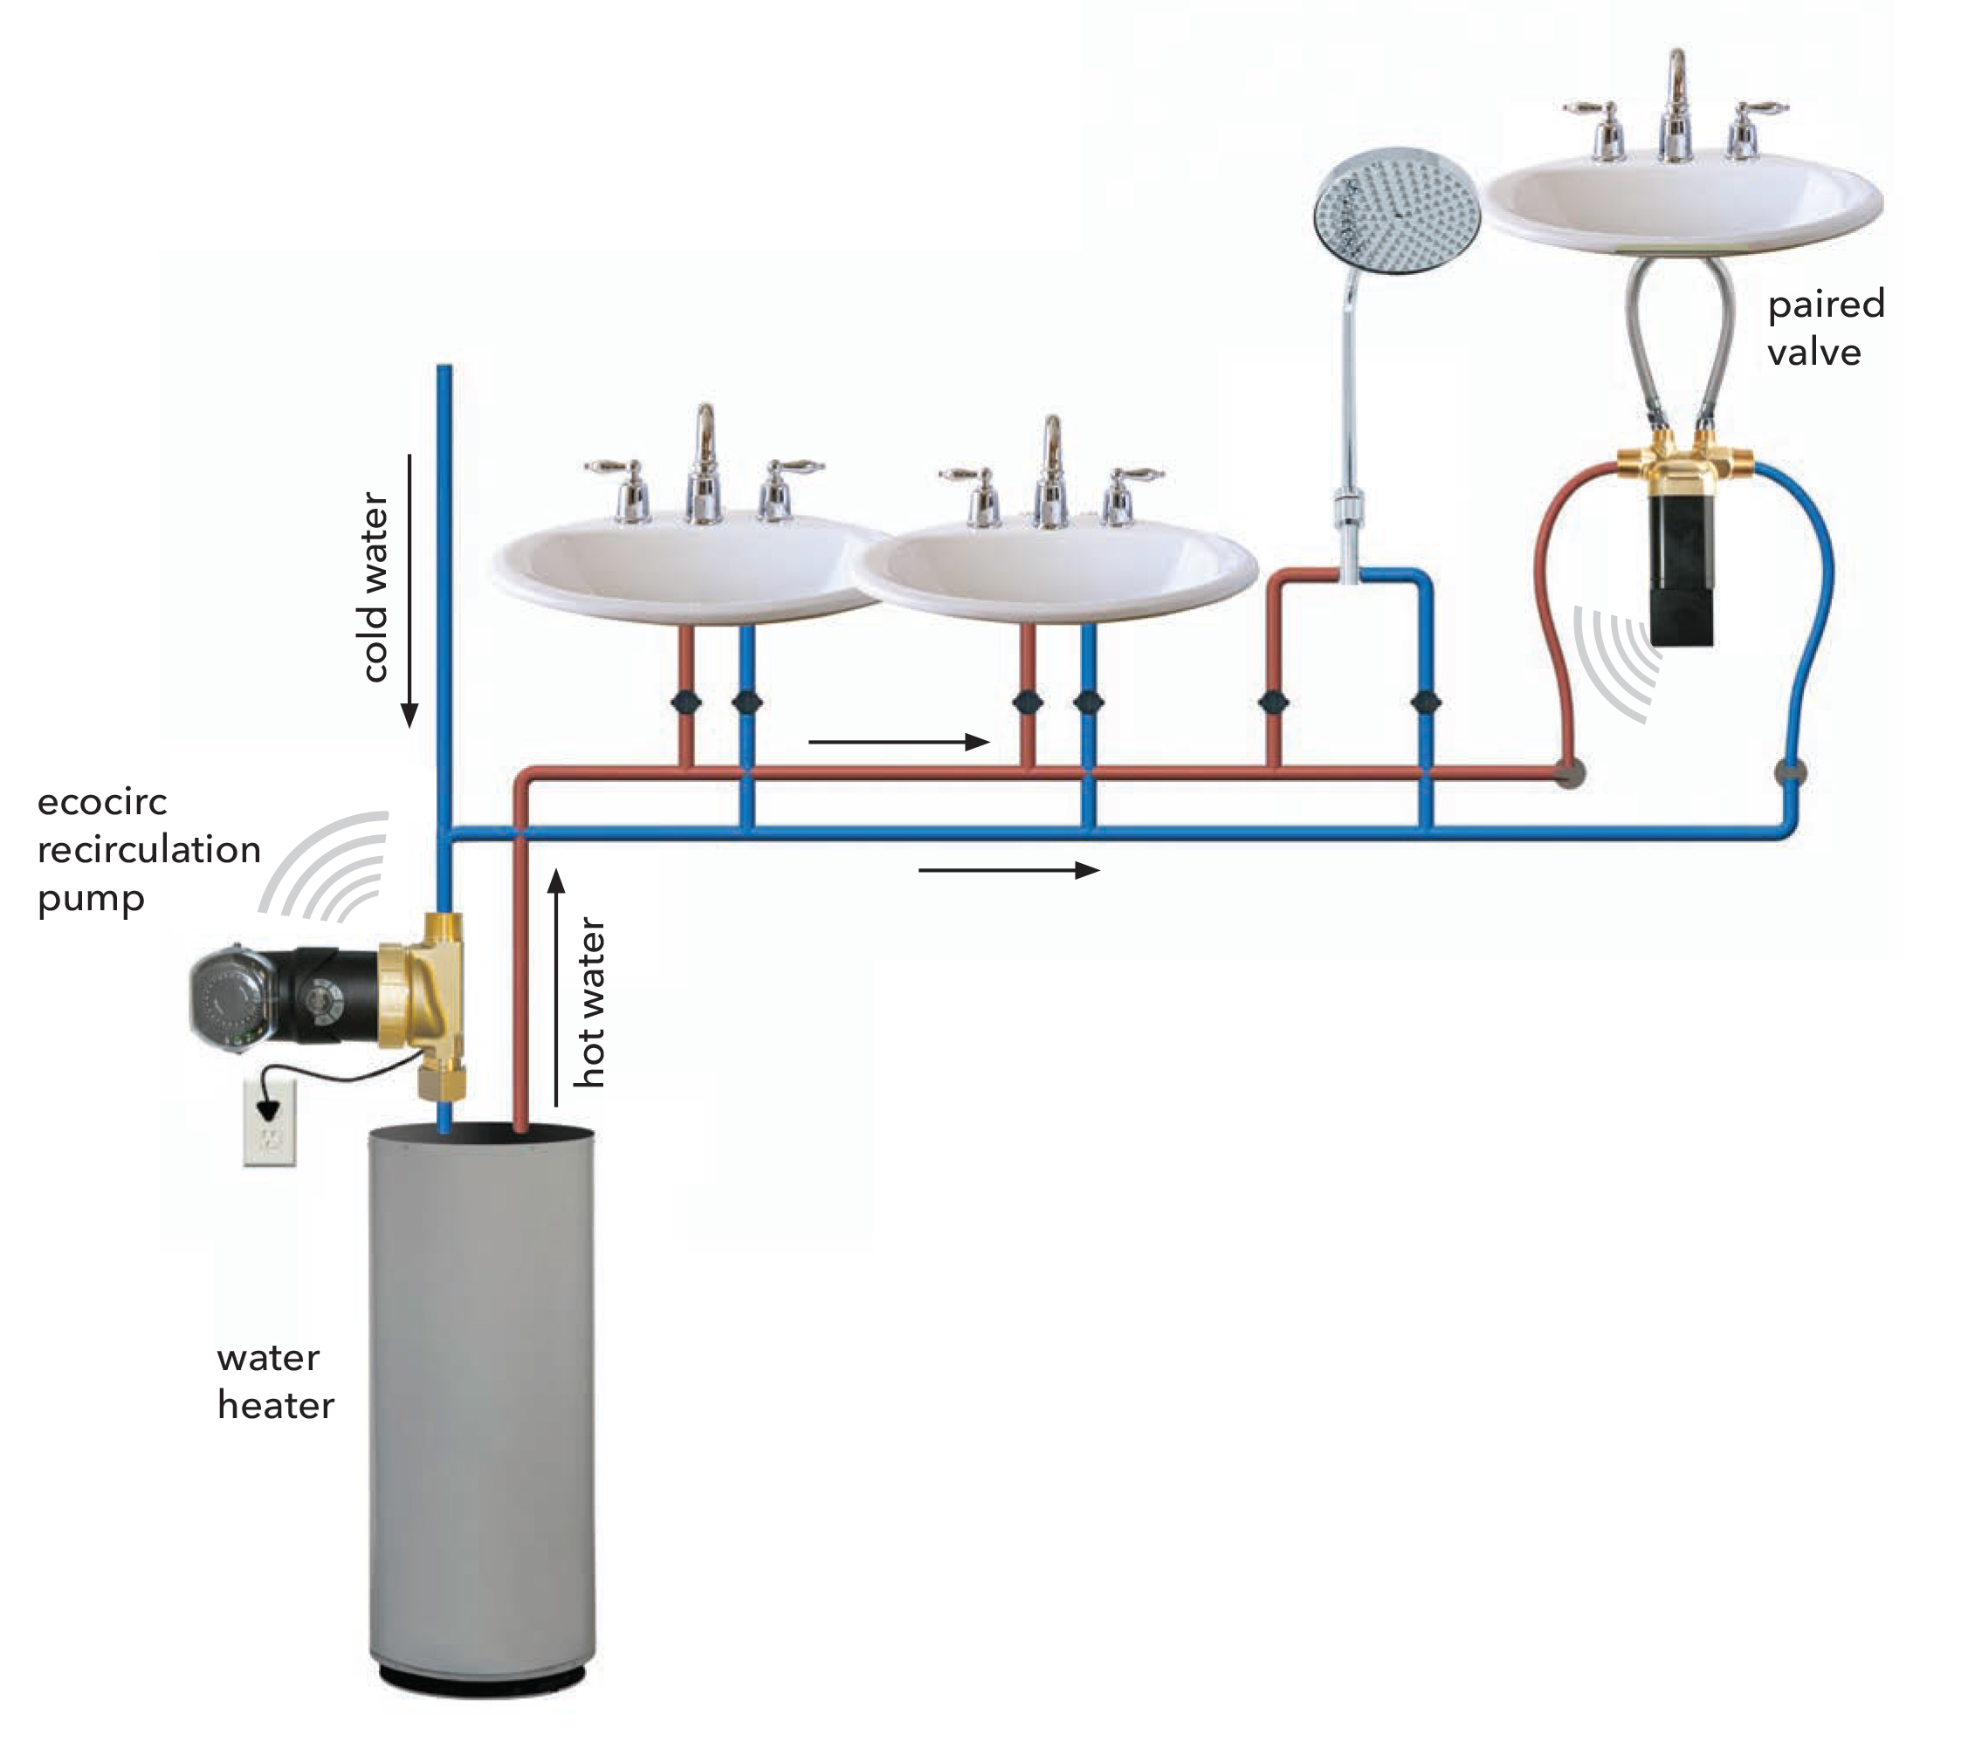
Easy operation
1. Use the thermostat on the pump to set the desired hot water temperature.
2. The mixing valve continuously monitors water temperature and the pump is activated by the timer or built-in temperature sensor.
3. When temperature falls to about 10ºF below your desired setting, the valve signals the pump to start.
4. When the pump starts, the valve opens to allow hot water to travel to the faucet. No recirculating line required!
5. When the valve detects water at the desired temperature, it signals the pump to stop, and the valve closes. The pump runs only when hot water needs replenishing.

Slide 6
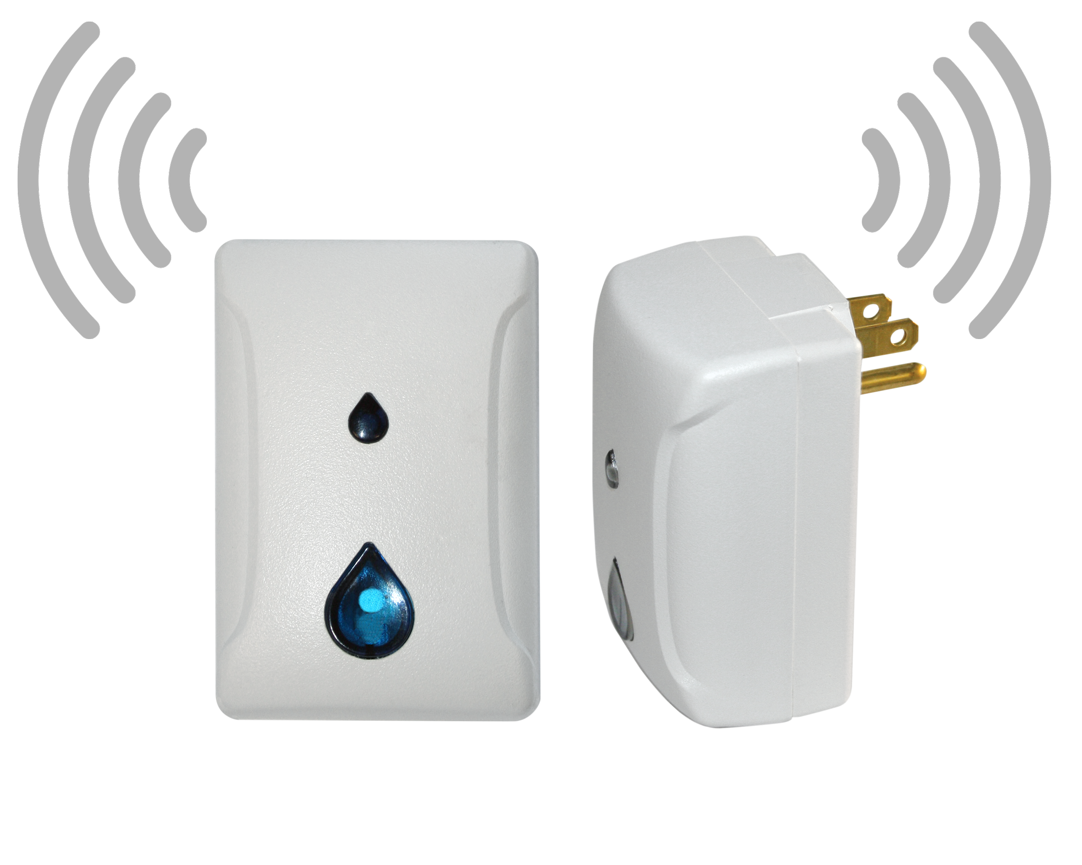
Choices increase efficiency
The optional push-button signal repeater plugs into any outlet and lets you override the timer with the simple push of the button. It can also be used as a signal booster for extended range capabilities.
Push button / signal repeater Part #6099B1500

Slide 7
Savings add up
The ecocirc® wireless runs on as little as 20 watts – costing just pennies per year
Simple retrofit installation
Makes water heaters, dishwashers and washing machines more efficient
Reduces water and gas or electric utility bills
Can pay for itself in as little as three years

Slide 8
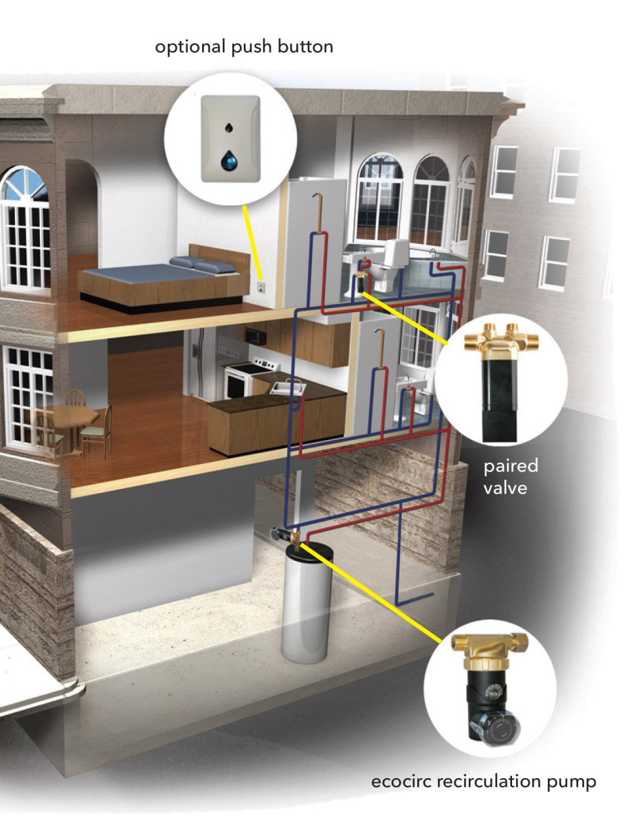
Simple retrofit installation
Now you can offer customers an ecocirc® instant hot water wireless system without the messy, disruptive and costly renovation work required to install a recirculation line.

Slide 9
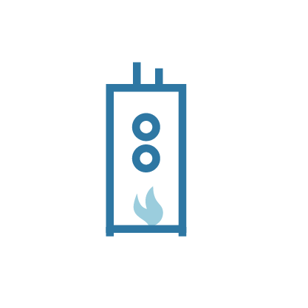
Save water and money
At 14,000 gallons of water a year:
Gas water heater cost saved: $111.50 per year
Sewer cost saved: $111.68 per year
Water cost saved: $95.45 per year
Pump charges: -$0.98 per year
Total savings: $321.16 per year
Cost analysis based on data from City of Ottawa, Ontario Energy Board & Hydro Ottawa – 2016
Savings shown are for illustration only. Actual savings will vary based on household’s potable water consumption, energy costs, fixtures and appliances.
Pump charges based on a 4-min run time per hour - 16 hour per day @ 350 days per year

Slide 10
What’s your hot water waste number?
Time from turning on faucet to getting hot water: 150 seconds
Faucet flow rate:
2.5 gallons per minute (GPM)
Divide time by 60 to get minutes:
150 / 60 = 2.5 minutes
Multiply water going down the drain by time you wait:
2.5 GPM x 2.5 = 6.25 Gallons
Multiply by the number of days in a year:
6.25 x 365 = 2,281 gallons wasted per year
Calculate how many times a day someone in your house will stand and wait for hot water:
6 x 2281 =13,687
Save up to 14,000 gallons a year with the ecocirc® wireless
Faucet flow rate listed by manufacturer. Results will vary based on fixture distance and flow rate from hot water tank.

